Slide 1


Performance Metrics
Notes:
Different performance metrics are used to evaluate classification models. In this presentation, we introduce some of the common metrics used for benchmarking classification models and will provide examples.

Slide 2
Accuracy
 |  | Predicted
 |  | Negative | Positive
Actual | Negative | TN | FP
 | Positive | FN | TP
The accuracy of a classification model is the fraction of predicted values that are correctly classified
Accuracy= (TP+TN)/(TP+TN+FP+FN)
Notes:
Accuracy is considered as one of the most common metrics for benchmarking a classification model. The accuracy of a classification model is a fraction of predicted values that are correctly identified. Subsequently, we can define accuracy as the ratio of the true positives plus the true negatives which is the total number of truly classified observations divided by total numbers of observations, which is true positive plus true negative plus false positive plus false negative.

Slide 3
Accuracy
Assumes equal cost for both kinds of errors
is 99% accuracy good?
– can be excellent, good, mediocre, poor, terrible
– depends on problem
Let’s consider a cancer detection classification model. Suppose only 0.01% of screened patients are diagnosed with cancer. Now imagine a dumb classifier that classifies all patents as not having cancer. What is the accuracy of this model?
The accuracy is 99.99% since it classifies 99.99% of the patients correctly, but obviously it is a useless classifier!
Notes:
Now you might ask yourself, what is a good accuracy for a classification model. For example, if you have a 99% accuracy for a model, can it be considered as excellent? Well the answer to this question very much depends on the problem. A 99% accuracy can be considered as excellent, good, medium, poor, or even very bad. Let’s discuss this in an example. Suppose you have only 0.01% of screened patients as being diagnosed with cancer; now imagine you have a dumb classifier, which classifies every patient as not having cancer. What is the accuracy of this model? Well, as you might have guessed, the accuracy of this model is 99.99%. That’s because out of all of the patients, 99.99% of the patients are being correctly classified; but is this really a good classification model? Obviously not, so this is one of the difficulties associated with interpretation of accuracy as a good measure of performance metric for a classification model.

Slide 4
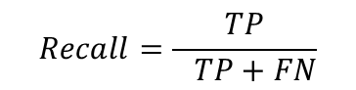
Recall (Sensitivity)
We observed that accuracy is not a good measure of performance, especially for imbalanced data categories.
Intuitively, we should maximize the ability of a model to find all the relevant cases within a dataset. This is called “Recall” or “Sensitivity”.
Formally, recall is the number of true positives divided by the number of true positives plus the number of false negatives.
 |  | Predicted
 |  | Negative | Positive
Actual | Negative | TN | FP
 | Positive | FN | TP
$$Recall=\frac{TP}{ TP+FN}$$
Notes:
So as we have seen, there are many scenarios where accuracy is not a good measure of performance for the classification model. Another measure of performance is recall, or sensitivity. Intuitively, the idea is to maximize the ability of the model to find relevant cases within the data set. This is normally represented by recall or sensitivity. Formally, recall is the number of true positives divided by the number of true positives plus the number of false negatives. In other words, recall represents the fraction of the positive cases that were correctly identified by the model.

Slide 5
Quiz: Test Your Knowledge
What is the Recall for the classifier in the previous example which would classify all patients as not having cancer?
1
0.5
0
Can not say
The answer is C. The model did not detected any correct positive cases (TP=0) so the recall is 0.

Slide 6
Recall
Recall seems like a performance metric that is much better that the accuracy.
Can we rely merely on recall to express the performance a classifier?
In the previous example, suppose the model would classify all patients as having caner. What would be the recall for the model?
The recall for the model would be 1 since there was no negative prediction and so TN=0 and FN=0. Therefore recall would be TP/(TP+0)=1.
This means that Recall is not sufficient on its own!
Notes:
The question is, can we rely merely on recall to express the performance of a classification model? Well the answer is no. Let’s consider an example here; Consider the previous example, when the model was trying to predict the cancer status of patients. In this case, imagine that the model classified all patients as having cancer, what would be the recall for this model? Well the recall for the model would be one. Since there was no negative prediction, and therefore true negatives and false negatives will be both equal to zero. The recall will be true positive divided by true positive plus zero, which is equal to one. Obviously, this is a terrible model. So, this means recall on its own may not be sufficient to express performance of classification models.

Slide 7
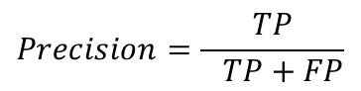
Precision
Precision is defined as the number of true positives divided by the number of true positives plus the number of false positives.
While recall expresses the ability to find all positive instances in a dataset, precision expresses the proportion of the data points our model says was positive actually were positive.
Balancing between Precision and Recall is the same balancing between False Positives and False negatives.
 |  | Predicted
 |  | Negative | Positive
Actual | Negative | TN | FP
 | Positive | FN | TP
$$Precision=\frac{TP}{ TP+FP}$$
Notes:
Precision is another important metric for representing the classification performance. Precision is defined as the number of true positives divided by the number of true positives plus the number of false positives. In other words, while recall expresses the ability of the model to capture all positive instances in a data set, precision expresses the proportion or percentage of the data points that our model claims to be positive. Obviously balancing between the precision and recall is the same as balancing between the positive and false negatives as we have seen before.

Slide 8
Quiz: Test Your Knowledge
What is the Precision for the classifier in the previous example which would classify all patients as having cancer?
1
0.0001
0.01
0
The answer is B. In this case, all cases were classified as positive but in reality only 0.01% were truly positive that means TP=0.0001*(TP+FP) => TP/(TP+FP)=0.0001 that is the definition of the precision

Slide 9
True Positive Rate (TPR) and True Negative Rate (TNR)
Recall, also known as Sensitivity or True Positive Rate (TPR), is the proportion of positive cases which were correctly identified by the model.
In our example, it is the proportion of people that tested positive and are positive of all the people that actually are positive (i.e. what proportion of positive cases were correctly identified by the model)
Specificity or True Negative Rate (TNR) is the proportion of negative cases which were correctly identified by the model. False Positive Rate(FPR)=1-TNR.
As with sensitivity, it can be looked at as the probability that the test result is negative given that the patient is not sick.
Notes:
True positive rates and true negative rates are also two other metrics that you might hear. True positive rate is the same as recall, which is the proportion of positive cases, which were correctly identified by the model. In the previous example of cancer detection, recall or the true positive rate, can be considered as the proportion of people that tested positive and actually are positive and have cancer. Specificity, or true negative rates on the other hand, is the proportion of the negative cases that were correctly identified by the model.

Slide 10
Quiz: Test Your Knowledge
Consider the cancer screening classification model. Which of the following statements is correct?
A. With higher recall, more healthy people are labeled as sick
B. With higher specificity, less healthy people are labeled as sick
C. With higher specificity, fewer actual cases of disease go undetected
D. With lower recall, fewer actual cases of disease go undetected
The answer is B. The specificity or true false negative rates defines what proportion of negative cases which were correctly identified by the model. In this example, negative cases are healthy people.

Slide 11
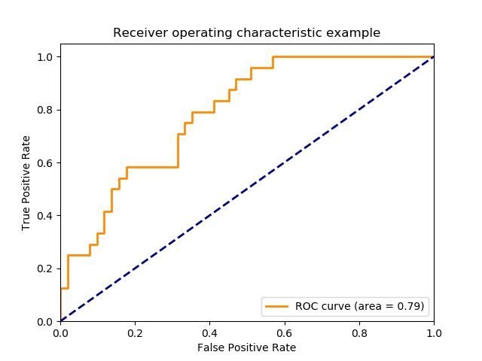
Receiver Operating Characteristic (ROC) curve
ROC curves typically feature true positive rate on the Y axis, and false positive rate on the X axis.
This means that the top left corner of the plot is the “ideal” point - a false positive rate of zero, and a true positive rate of one.
This is not very realistic, but it does mean that a larger area under the curve (AUC) is usually better.
Notes:
Another common performance metric is referred to as area under the curve of the ROC curve. ROC stands for receiver operating characteristic curve and is a curve that can be compiled by plotting the true positive rates versus the false positive rates. Considering the ROC curve, the top left corner of the curve is the ideal point, where the true positive rate is equal to zero, meaning that we have captured all positive instances in our data set. While the false positive rate is equal to 0, meaning that we haven’t committed any mis classification in doing so. By plotting the true positive rates against the false positive rates, the ROC curve is compiled. The performance of classification model is proportional to the area under this curve. Obviously as you can see, the ideal case would be the top left corner, which means that the area under the curve would be equal to one. In this slide, you can see an example of the ROC curve shown in orange. The area under the curve, or the AUC in this case, is shown as 0.79.

Slide 12
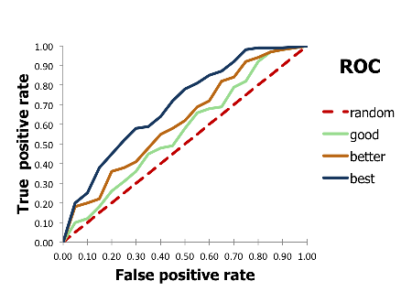
Receiver Operating Characteristic (ROC) curve
Notes:
We can see examples of a few classification models here. A random model is shown as the dotted line, in this case as you can see, the true positive rate increases with the same rate as false positive rates. For example, when the true positive rate is 20 percent, the false positive rate is also 20 percent. Also, as you might have guessed, the area under the curve of a random model would be equal to 0.5. in other words, the AUC of a random model is equal to 0.5. the higher the area under the curve of the ROC, the better would be the model. You can see the best model in this example would be shown in blue, and the second best model is shown as brown.

Slide 13
Example
library(ISLR) library(dplyr) library(caret)
set.seed(123) Index_Train <- createDataPartition(Default$default, p = .7, list = FALSE) Default_Train<-Default[Index_Train,] Default_Test<-Default[-Index_Train,] Model=glm(default~student + income + balance ,data=Default_Train, family = 'binomial') prob<-predict(Model,Default_Test, type = "response") class_prediction <- ifelse(prob > 0.2, "Yes", "No")
Notes:
Let’s consider the credit default example again and examine different classification metrics. The first thing is to load the ISLR library dplyr package and the caret package that we are going to use. We then divide the data set into the train and test, in order to do that, we use the create data partition, which is a part of the caret package. The create data partition creates the index for us for the training, all what we need to do is define the data set and the target variable, which in this case is default and the percentage of the observation that we want to return in the train data set. Previously, we have used the sample function to achieve this goal. Now that we have our default train and our default test, we can build the model. So, in that case, we have model equal to glm, and then we try to predict the default using the student status income and balance. Family is equal to binomial, which means we are interested in building a logistic regression model. We’ll then use the predict function in order to calculate the probabilities of default for each of the observations in the test data set. Finally, we get the class predictions by applying the cutoff. So, in this case, the class prediction would be yes if the probability is greater than 0.2. 0.3 in here is our threshold, or cutoff.

Slide 14
Example
T=confusionMatrix(class_prediction, Default_Test$default, positive="Yes") T
## Confusion Matrix and Statistics ## ## Reference ## Prediction No Yes ## No 2824 37 ## Yes 76 62 ## ## Accuracy : 0.9623 ## No Information Rate : 0.967 ## ## Sensitivity : 0.62626 ## Specificity : 0.97379 ## ## 'Positive' Class : Yes ##
Notes:
Now that we have the class predictions and the growth truth values for the default status in the test data set, we can use the confusion matrix method from the caret package to calculate the confusion matrix in addition to other performance metrics. So, in this case we have T equal to confusion matrix plus predictions and default test dollar sign default, and we identify yes as the positive cases. Looking at the results we can see the confusion matrix, so there are 2,824 cases where the model predicted as no and they were in fact no, and also we can see 62 positives as well. There are also 37 false negatives, and 67 false positives. We can also see the accuracy as 0.96, roughly 96 percent and sensitivity and specificity are also shown there as well. Remember that specificity is the same as the true negative rate as well and sensitivity is the same as the true positive rate.

Slide 15
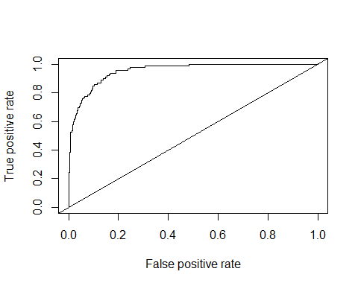
Example
pred <- prediction(prob,Default_Test$default) roc.perf = performance(pred, measure = "tpr", x.measure = "fpr") plot(roc.perf) abline(a=0, b= 1)
Notes:
We can also use the performance method from the caret package to calculate various performance metrics and make visualizations. So, in this case, first we will calculate predictions by applying the prediction function to the probabilities and the ground truth values, and then the performance method takes these predictions and calculates various performance measures. So, in this case we are interested in measuring the truth pulse rate, or tpr versus the false positive rate, or fpr. So, we set the measure as tpr and x measure as fpr. If you recall, plotting the two positive rates against the false positive rate is the same as the ROC curve. So, in this case, we have the ROC curve and we can plot it as well. So, by plotting the ROC curve, and our ROC is plotted in here as well, the area under the curve of the ROC curve is referred to as AUC and is an important performance metric as we have seen before. We can also use the abline to plot the random model reference for us. So, we can see that this model is substantially better than a random model.

Slide 16
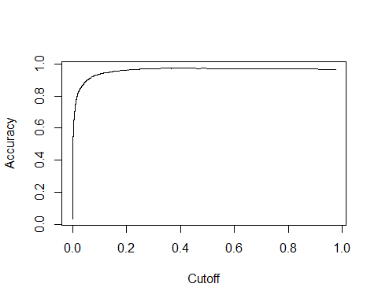
Example
auc.perf = performance(pred, measure = "auc") auc.perf@y.values
## [1] 0.9540195
acc.perf = performance(pred, measure = "acc") plot(acc.perf)
Notes:
We can use the performance method to calculate the auc, or accuracy, or other performance matrix. For accuracy, we have performance and then we pass the predicted values and set the measure equal to AUC. And then we can read the values as y values, so auc dot perf at sign y dot values, prints out the actual values of the auc, which is in this case 0.95 which is a good model. We can also plot the accuracy versus the cutoff. For this we have performance and then we pass the predicted value and we set the measure as accuracy or acc. In this case, we can see the plot of the accuracy versus the cutoff. From the plot it can be see that the cutoff needs to be greater than 0.2 to have a reasonable accuracy.

Slide 17
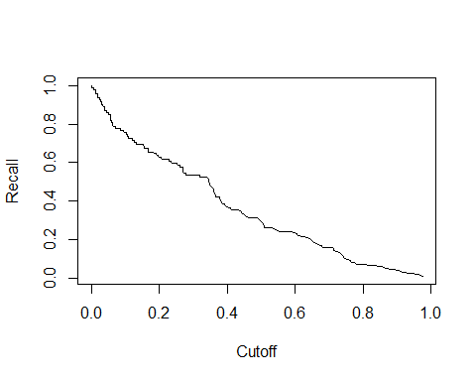
Asymmetric Costs
rec.perf = performance(pred, measure = "rec") plot(rec.perf)
Notes:
Here, we can see the plot of the recall versus the cutoff. As one might expect, increasing the threshold or cutoff, results in decrease in recall. This is because increasing the cutoff makes it more difficult to classify the predictions as positive and therefore recall would decrease.

Slide 18
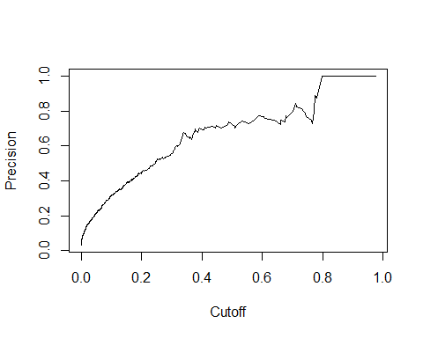
Example
prec.perf = performance(pred, measure = "prec") plot(prec.perf)
Notes:
On the other hand, increasing the cut off results in an increase in precision as well. Because as the cut off is increased, we have a lower number of false positives, because those cases that would be considered as positives are more likely to be actually positive cases. So as we can see, cut off has a role in balancing between the false positive and false negative cases, and therefore the optimal value of cutoff depends on the cost associated to each error type.

